Slide 1
Water Quality Analysis
119EC0026
Joseph Srujan Eda

Slide 2
Problem Statement
Our task is to understand all the factors that affect water potability and train a machine learning model that can classify whether a specific water sample is safe or unfit for consumption.

Slide 3
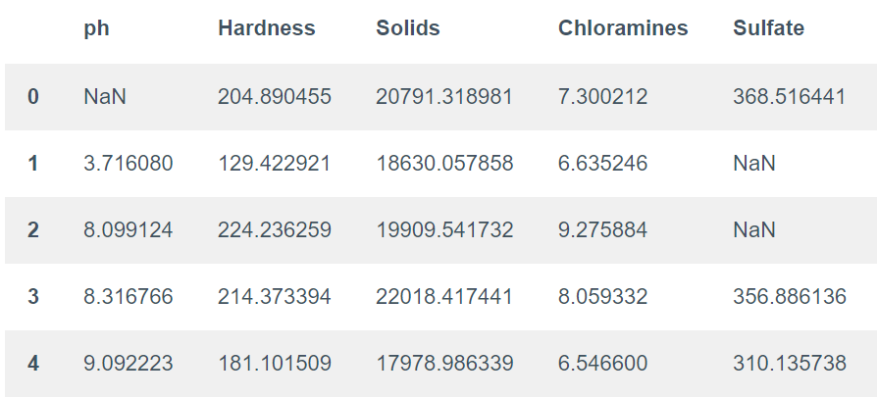
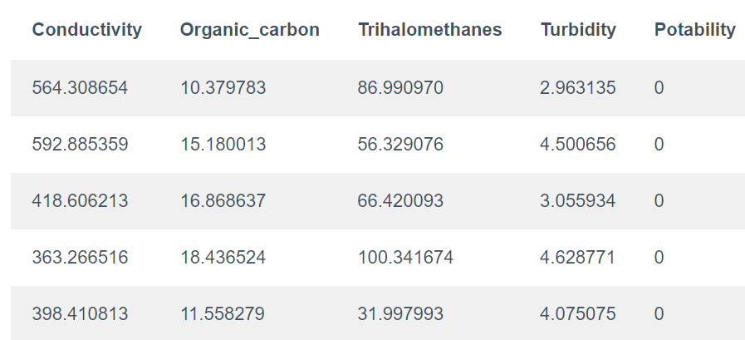
Data given in the data set
In the last column we have null values. So we should remove them.

Slide 4
Libraries required
Matplot lib
Pandas
Seaborn
Numpy

Slide 5
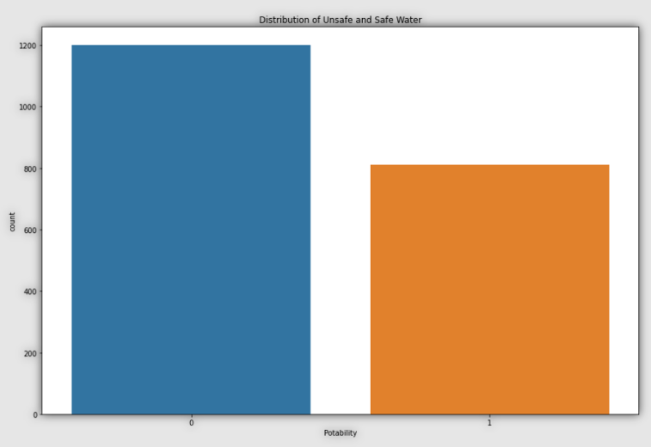
Procedure
The Potability column of this dataset is the column need to be predict because it contains values 0 and 1 that indicate whether the water is potable (1) or unfit (0) for consumption. So the distribution of 0 and 1 in the Potability column

Slide 6
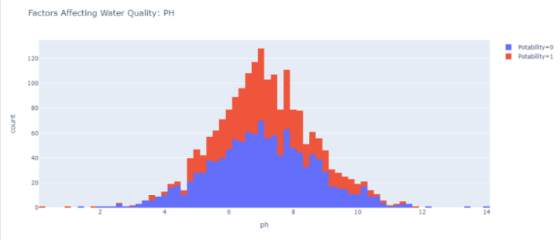
The above dataset is not balanced because samples of 0s are more than 1s. As we know, there are no factors that we cannot ignore that affect water quality, so we explore all the columns one by one. Let’s start it from ph column:

Slide 7
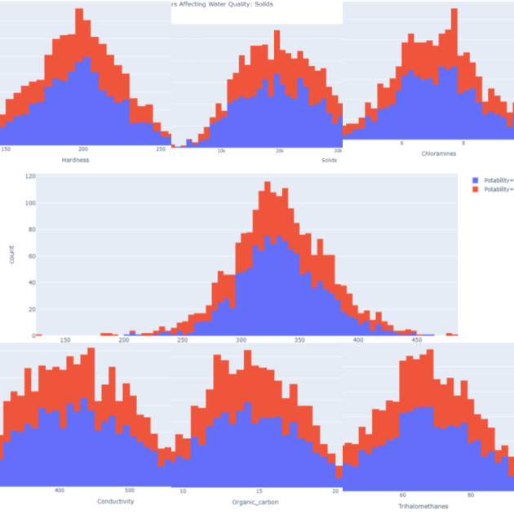
And similarly for all parameters we should repeat the above mentioned method and check the dependency of water quality on that specific parameter.

Slide 8
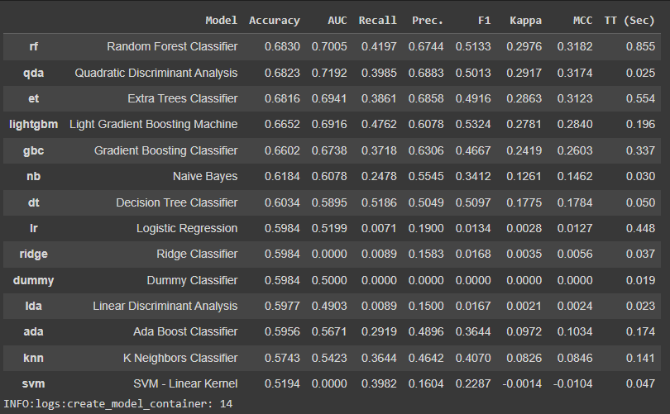
Identifying required classifier
Using pycaret classification module from python we have checked accuracy across several ML algorithms and random forest has more accuracy so we choose this algorithm for classification.

Slide 9
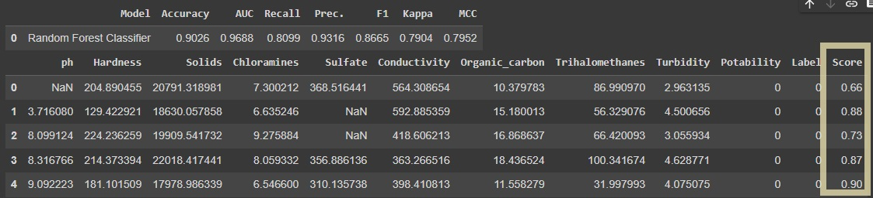
Results

Slide 10
Conclusion
So this is how we can analyze the quality of water and train a machine learning model to classify safe and unsafe water for drinking. And access to safe drinking water is one of the essential needs of all human beings.

